Slide 1


SAJIT KADAM
SUB: OPERATIONS
BATCH BILLGATES(BG)
ROLL NO=021330024406
PRODUCT= JAM

Slide 2
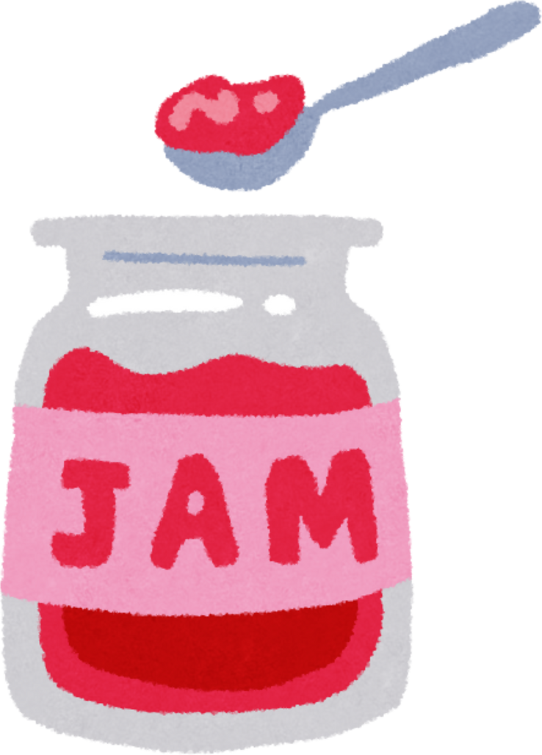
1
The Sweet Science of Supply Chain Management: A Case Study of Jam
Yummy!!!
OPERATIONS

Slide 3
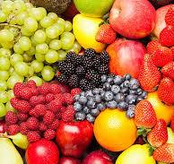
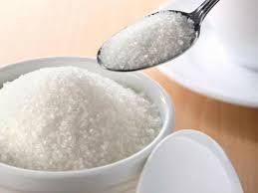
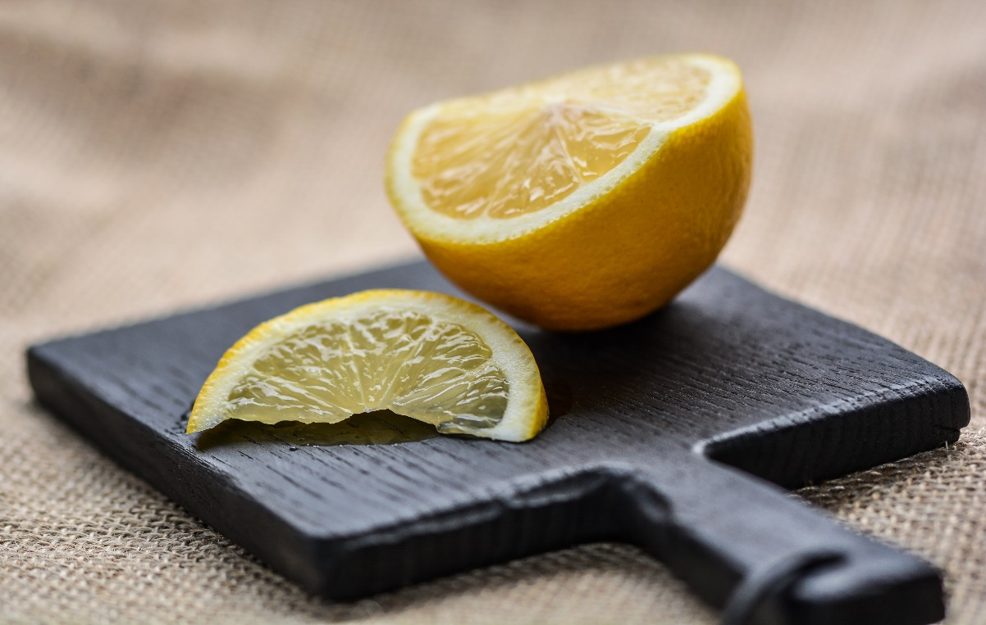
REQIRED RAW MATERIAL
2
Fruits
Sugar
Acid
Additional ingredients might include:
1) Flavorings
2) Coloring
OPERATIONS

Slide 4
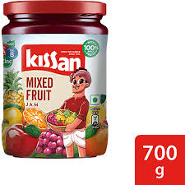
BRANDS WHICH ARE OFFERING THIS PRODUCT
3
kissan
mapro
Bhuira
Natureland Organics
OPERATIONS

Slide 5
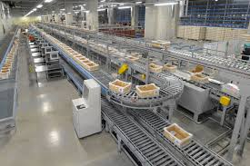
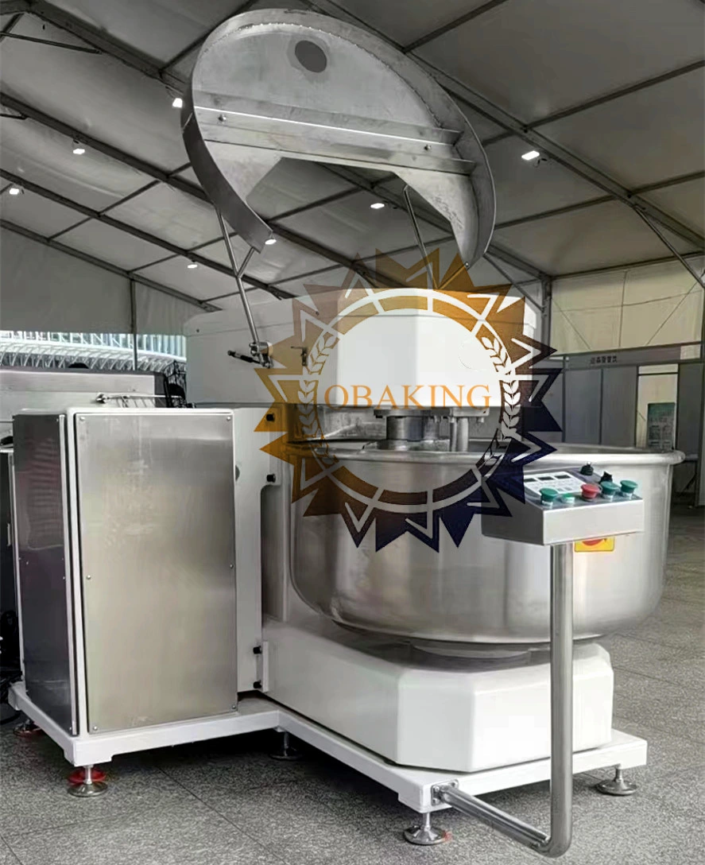
TOOL’S,EQUIPMENTS AND MACHINES
4
Fruit Handling and Preparation:
Conveyor belts
Washing machines
Sorting machine
Peeling, coring, and slicing machines
Pulping machines
2.Cooking and Processing:
Large-capacity vacuum cookers
Heat exchangers
Homogenizers.
Mixers
OPERATIONS

Slide 6
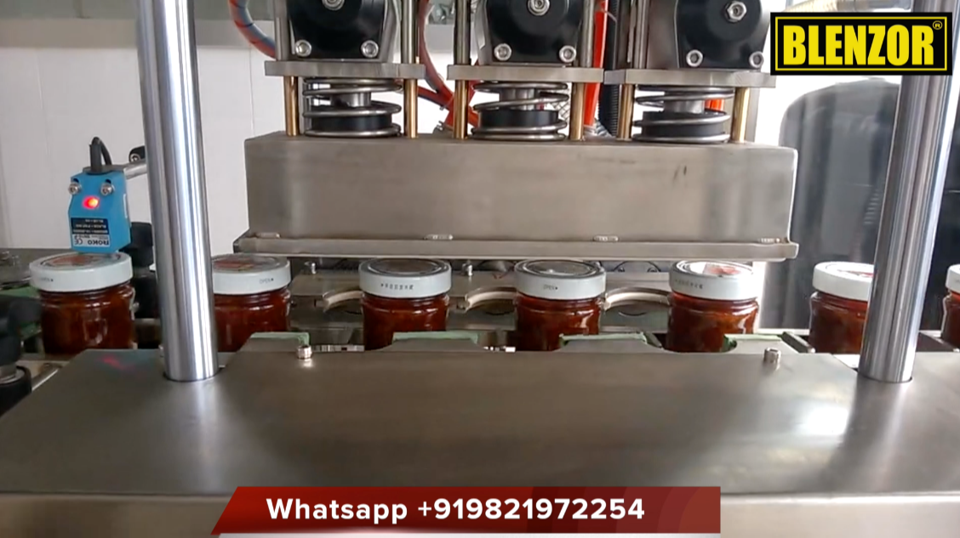
TOOL’S,EQUIPMENTS AND MACHINES
5
Filling and Sealing:
Automatic filling machines
Capping machines
OPERATIONS

Slide 7
GENERAL TIMEFRAME TO MANUFACTURE 1 UNIT
6
Fruit preparation: 5-10 minutes per batch (depending on the fruit and quantity)
Cooking and processing: 30-60 minutes per batch
Filling and sealing: 2-3 minutes per jar
Sterilization: Varies based on method (e.g., retort processing can take several minutes)
Cooling and labeling: 10-15 minutes per batch
Packaging: Varies based on packaging type and quantity
Total estimated time: Approximately 1-2 hours per batch.
OPERATIONS

Slide 8
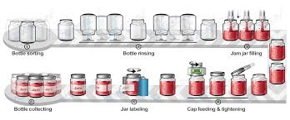
SUPPLYCHAIN PART
7
Packaging Process
Jar Cleaning and Sterilization
Capping
Labeling
OPERATIONS

Slide 9
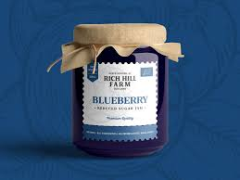
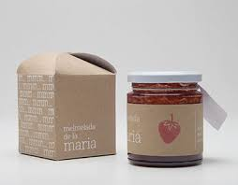
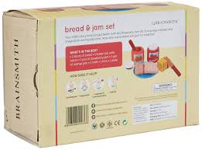
SUPPLYCHAIN PART
8
Types of Packaging for Jam
Primary Packaging: Glass jars and Plastic jars
Secondary Packaging: Cardboard boxes and Tertiary Packaging
Tertiary Packaging
Pallets
OPERATIONS

Slide 10
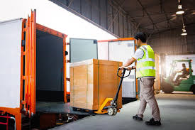
9
MATERIAL HANDLING ACTIVITIES IN JAM MANUFACTURING
Raw Material Handling
In-Process Material Handling: Conveyors, Forklifts, Pallet jacks, Conveyance systems, Storage racks
Finished Product Handling
OPERATIONS

Slide 11
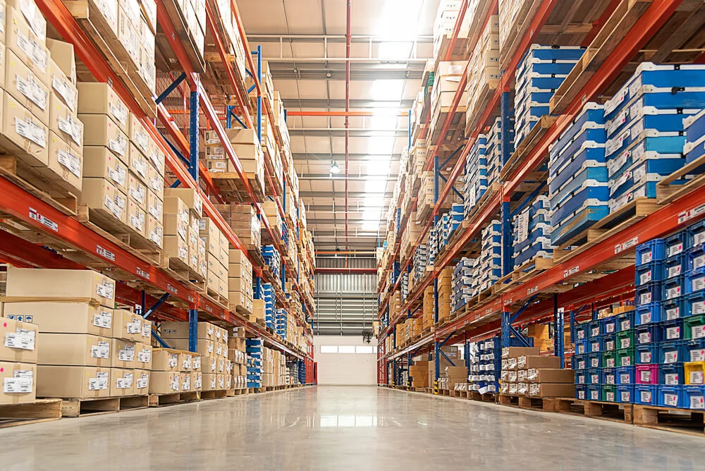
WAREHOUSING IN JAM MANUFACTURING
10
Raw Material Warehouse
Finished Product Warehouse
Packaging Material Warehouse
OPERATIONS

Slide 12
11
INVENTORY MANAGEMENT SYSTEMS
Manual Systems: Using spreadsheets or paper-based records.
Enterprise Resource Planning (ERP) Systems: Integrated software for managing various business functions, including inventory.
Warehouse Management Systems (WMS): Specifically designed for managing warehouse operations and inventory
OPERATIONS

Slide 13
TRANSPORTATION PROCESS IN JAM MANUFACTURING
12
Procurement: Raw materials, such as fruits, sugar, pectin, and other ingredients, are sourced from various regions. Mode of Transport
Trucks, Most commonly used for transporting raw materials within a country.
Rail, For long distances and bulk quantities.
Sea, For international transportation of fruits and other ingredients.
Air, Used for perishable items or urgent shipments.
Storage and Handling, Raw materials require proper storage and handling during transportation to maintain quality. Refrigerated trucks or containers are often used for perishable fruits.
* *Storage and Handling:* Raw materials require proper storage and handling during transportation to maintain quality. Refrigerated trucks or containers are often used for perishable fruits
OPERATIONS

Slide 14
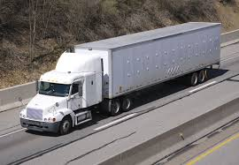
TRANSPORTATION PROCESS IN JAM MANUFACTURING
13
Procurement: Raw materials, such as fruits, sugar, equipment, machineries pectin, and other ingredients, are sourced from various regions. Mode of Transport
Trucks
Rail
Sea
Air
Storage and Handlind
* *Storage and Handling:* Raw materials require proper storage and handling during transportation to maintain quality. Refrigerated trucks or containers are often used for perishable fruits
OPERATIONS
OPERATIONS

Slide 15
Thank You!!

